Slide 2
MINOR-I PRESENTATION
Shortest Path Algorithms for Optimization of Flight Routes
Prepared by:
Aniruddh Saxena | R110218023-CCVT B1
Dishant Bisht | R110218051-CCVT B1
Harshit Joshi | R110218061-CCVT B2
Manya Aeron | R110218091-CCVT B2
Guided by:
Mr. Sandeep Pratap Singh
Department of Virtualization

Slide 3
Introduction
Over the last few years, the aviation sector has been evolving rapidly. Flights being the fastest mode of travelling, has become the prime choice of people to travel across the globe.
There are mainly two types of flight choices ie. A non-stop flight in which there are no stops in between and a connecting flight where passengers are required to change the plane in between the origin and destination route at a particular stop.
This project is designed in order to provide the best feasible flight route for passengers as per their choice of flight type, source-destination preferences.

Slide 4
Problem Statement
Given two points i.e. origin and destination, the problem lies in searching airline routes that connect the two ends of the pair and provide an efficient, profitable path and satisfy the constraint of time, distance, cost.
To tackle this problem, we have come with a solution that will tell us the shortest path between two points by different shortest path algorithms and would also compare them based on time complexity and for a matter of fact financially too.

Slide 5
Objectives
To start with, our main objective is to make a model that tells us the shortest path between a pair of origin and destination by using different shortest path algorithms hence making it useful to optimize the air route network system.
Sub-objectives are as follows:
Intensive study of different shortest path algorithm to calculate distance.
Comparison of different algorithms based on complexity, distance and cost.
To get the optimum distance between origin and distance if it contains a stop or multiple stops.

Slide 6
Software/ Hardware Requirement
Hardware:
RAM: 4GB
Disk Space: 4GB
Compiler:
GNU Compiler Collection (GCC)
Operating System:
Linux/Windows
IDE:
Eclipse C++

Slide 7
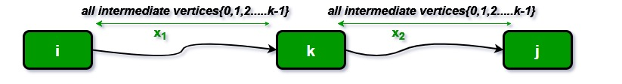
Algorithms
Floyd-Warshall’s algorithm:
The Floyd-Warshall’s algorithm is used for solving the All Pairs Shortest Path problem.
It finds the shortest distances between every pair of vertices in the given weighted directed Graph.
The time complexity of this algorithm is O (V3), where V is the number of vertices in the graph.

Slide 8
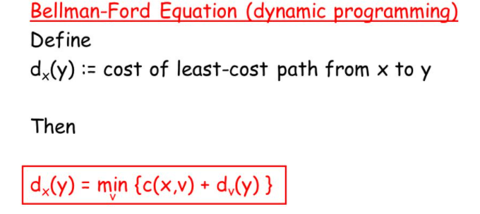
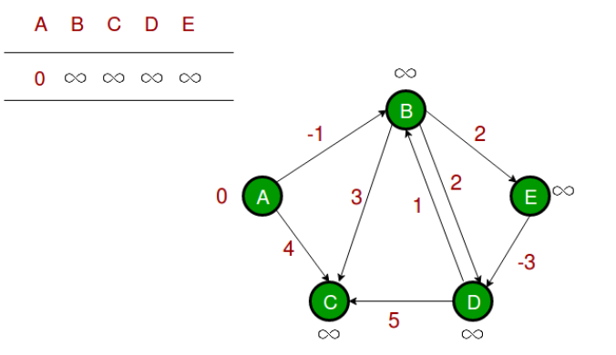
Bellman Ford
The Bellman–Ford algorithm is an algorithm that computes shortest paths from a single source vertex to all of the other vertices in a weighted digraph.
Solves single shortest path problem in which edge weight may be negative but no negative cycle exists. The time complexity of Bellman Ford is O(V3).

Slide 9
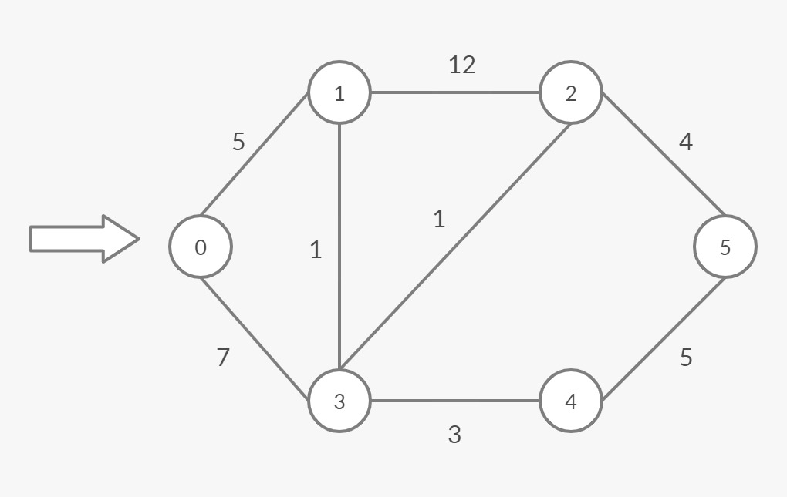
Dijkstra’s algorithm
Dijkstra’s Algorithm is used for finding the shortest path from a starting node to a target node in a weighted graph and creates a tree of shortest paths from the source node, to all the remaining nodes in the graph.
It finds the minimum value of all the vertices at once and estimates the optimal trajectory in minimal time.
The time complexity of Dijkstra is O(VLogV).

Slide 10
A* Algorithm
A* Search algorithms, unlike other traversal techniques, it has “brains”. What it means is that it is really a smart algorithm which separates it from the other conventional algorithms.
It is the most commonly used algorithm in case of map applications for finding optimal routes.
Our Implementation of this algo is unique
How ?
The ans is our very own designed data structure which we like to call …….The “PsuedoGraph”…

Slide 11
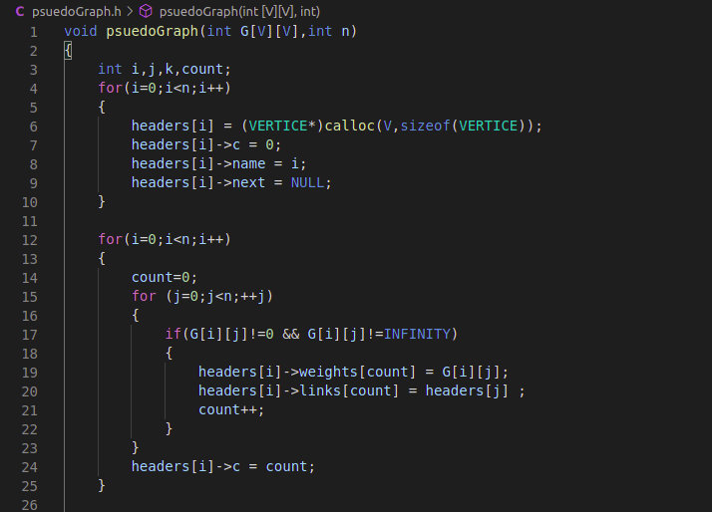
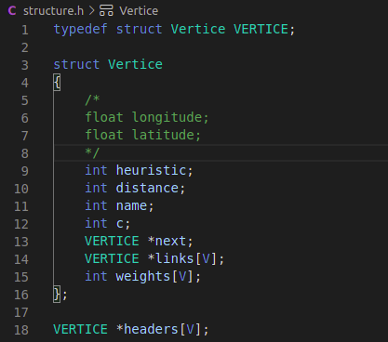
PsuedoGraph and Structure for Vertices

Slide 12
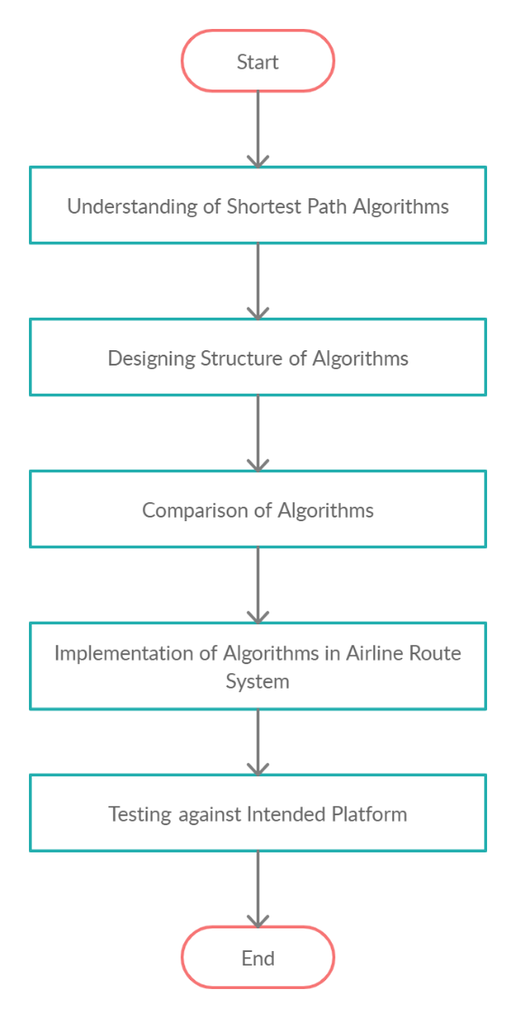
Research Methodology
The shortest path problem is about finding a path between 2 vertices in a graph such that the total sum of the edges weights is minimum
We will be using C language to support our intended design into a
working code
Using the modules and library in use we will make sure to compare all the
Shortest Path algorithms
Implementation of an Algorithm is a necessary step for a developer to jump
from a theoretical aspect to practical knowledge
Linux terminal-based implementation shall reveal the loopholes and
unidentified services in the usage and fixing of errors

Slide 13
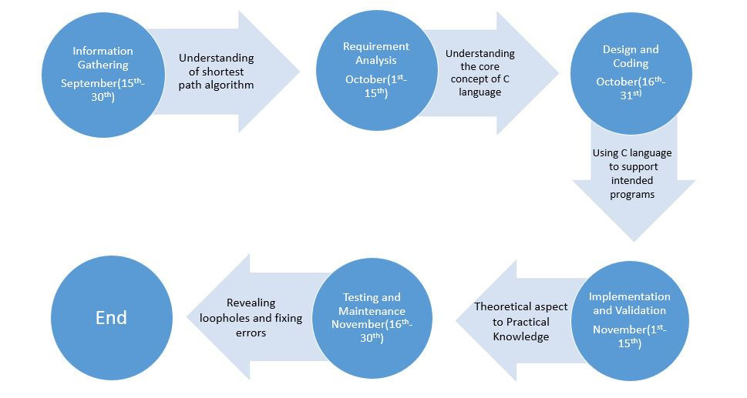
Pert Chart

Slide 14
Objectives Achieved So Far
We have completed two phase of our planned objective i.e. intensive study of different shortest path algorithm to calculate distance between two points and developing code for shortest path algorithms
Codes of each algorithm is made from scratch, to bridge the path for 3rd phase our objectives
Intensive study of shortest path algorithms | Achieved
Develop code for shortest path algorithms | Achieved
Comparison of different algorithms | In progress
Implementation of algorithms in airline route management system | In progress

Slide 15
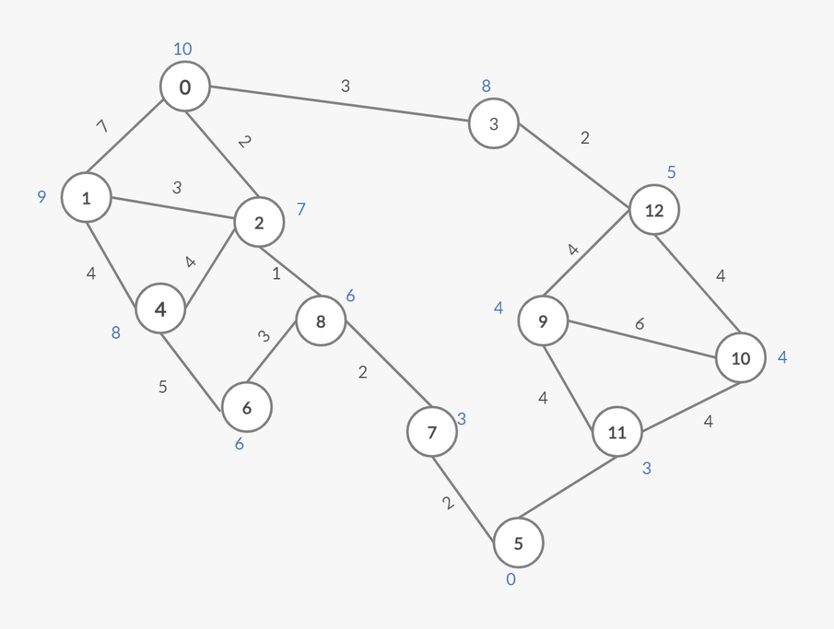
Sample Graph

Slide 16
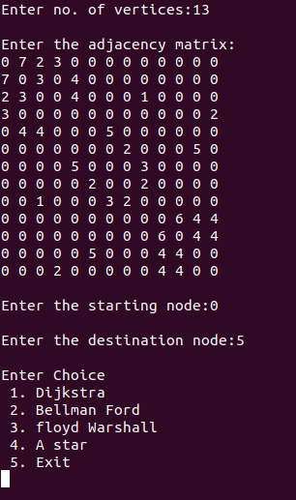
Outputs

Slide 17
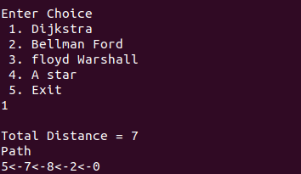
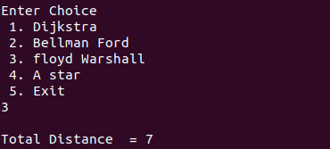
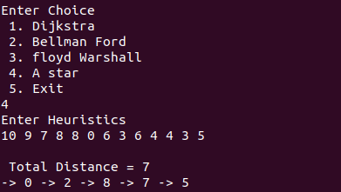
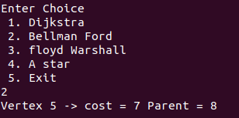
Dijkstra Algorithm
Floyd Warshall Algorithm
A* Algorithm
Bellman Ford Algorithm

Slide 18
References
https://www.hackerearth.com/practice/algorithms/graphs/shortest-path-algorithms/tutorial/
https://brilliant.org/wiki/shortest-path-algorithms/
https://dl.acm.org/doi/pdf/10.5555/1791129.1791184?download=true
https://www.researchgate.net/publication/310594546_A_Review_and_Evaluations_of_Shortest_Path_Algorithms
https://www.tutorialspoint.com/aviation_management/aviation_management_airline_routeplanning.htm
http://www.i3s.unice.fr/~kamal/publications/ICORES2018_AKI.pdf
https://warwick.ac.uk/fac/sci/dcs/research/em/publications/web-em/07/paperpham.pdf
Anany Levitin, Introduction to Design Analysis and Algorithms

